Slide 1
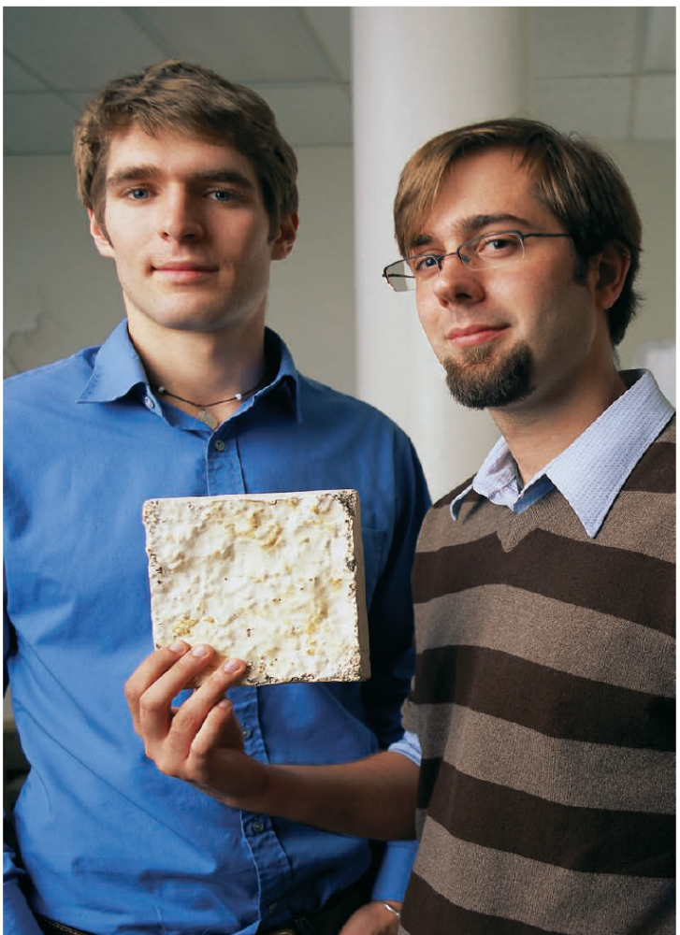
Chapter 12
The Importance of Intellectual Property
Bruce R. Barringer
R. Duane Ireland
12-<number>

Slide 2
Intellectual property
Intangible property that is the result of creativity, such as Trademarks, copyrights, etc.
Patents
Copyrights
Trademarks
Trade secrets
Other results of intellectual activity
  Know-how
  Chip (and other) designs
  Plant designs
  "Ways of doing"

Slide 3
The Importance of Intellectual Property
Intellectual Property
  Is any product of human intellect that is intangible but has value in the marketplace.
  It is called “intellectual” property because it is the product of human imagination, creativity, and inventiveness.
Importance
  Traditionally, businesses have thought of their physical assets, such as land, buildings, and equipment as the most important.
  Increasingly, however, a company’s intellectual assets are the most important.
12-<number>

Slide 4
The Importance of Securing Intellectual Property
https://www.youtube.com/watch?v=mOjEpEtkp8Y
12-<number>

Slide 5

Intellectual property
Intellectual property is important to the entrepreneur because it can generate profits and create a form of competitive advantage.

Slide 6
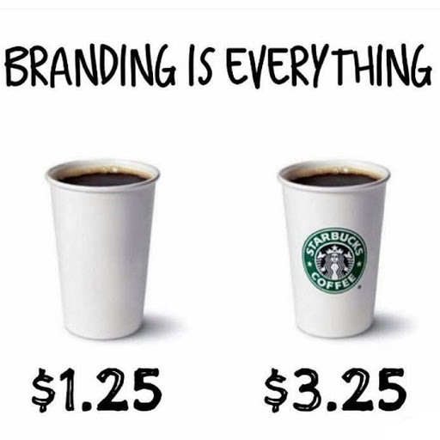
12-<number>

Slide 7
Determining What Intellectual
Property to Protect
Criteria 1
Criteria 2
Determine whether the intellectual property in question is directly related to the firm’s competitive advantage.
Decide whether the intellectual property in question has value in the marketplace.
12-<number>

Slide 8
Common Mistakes Firms Make in Regard to Protecting Their Intellectual Property
Not properly identifying
all of their
intellectual property.
Not fully recognizing
the value of their
intellectual property.
Not legally protecting the
intellectual property
that needs protecting.
Not using their
intellectual property as
part of their overall
plan for success.
12-<number>

Slide 9
Example
https://www.youtube.com/watch?v=auEdEYY3ao4
12-<number>

Slide 10
The Four Key Forms of Intellectual Property
Patents
Trademarks
Copyrights
Trade Secrets
12-<number>

Slide 11

Patents
Patents
  A patent is a grant from the federal government discussing the rights to exclude others from making, selling, or using an invention for the term of the patent.
12-<number>

Slide 12
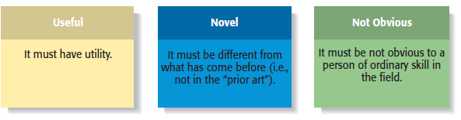
Three Basic Requirements for Obtaining a Patent
12-<number>

Slide 13
Patents
https://www.youtube.com/watch?v=Bb9EBtlGx7w
12-<number>

Slide 14
Types of Patents
Type
Type of Invention Covered
Duration
New or useful process, machine, manufacturer, or composition of material or any new and useful improvement thereof.
20 years from the date of the original application.
Utility
14 years from the date of the original application.
Invention of new, original, and ornamental design for manufactured products.
Design
20 years from the date of the original application.
Any new varieties of plants that can be reproduced asexually.
Plant
10-<number>

Slide 15
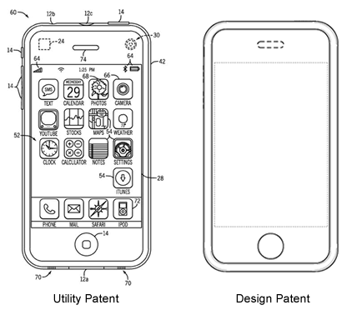

Utility & Design Patents
B
12-<number>

Slide 16
Q&A
Patent design is also called Industrial design:
A. True
B. False
12-<number>

Slide 17
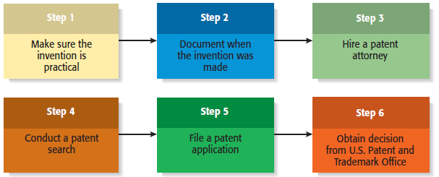
The Process of Obtaining a Patent
12-<number>

Slide 18
Patent Infringement
Patent Infringement
  Take place when one party engages in the unauthorized use of another party’s patent.
  The tough part (particularly from a small entrepreneurial firm’s point of view) is that patent infringement cases are costly to sue.
  https://www.youtube.com/watch?v=Hi6NEjq07CA
12-<number>

Slide 19
Trademarks
Trademark
  A trademark is any word, name, symbol, used to identify the source or origin of products or services and to distinguish those product or services from others.
  Trademarks also provide consumers with useful information.
  https://www.youtube.com/watch?v=J-PYuZOPrzI
12-<number>

Slide 20
Types of Trademarks
1 of 2
Type
Types of Marks Covered
Duration
Any word, name, symbol, or device used to identify and distinguish one company’s goods from another.
Examples: Jalalsons, Suzukhi,
McDonalds
Renewable every 10 years, as long as the mark remains in use.
Trademark
Similar to trademarks; are used to identify the services or intangible activities of a business, rather than a business’s physical products.
Examples: MCB, NUML
Renewable every 10 years, as long as the mark remains in use.
Service mark
12-<number>

Slide 21
Types of Trademarks
2 of 2
Type
Types of Marks Covered
Duration
Trademarks or service mark used by the members of a cooperative, association, or other collective group.
Examples: Pepsi, International Franchise Association
Renewable every 10 years, as long as the mark remains in use.
Collective mark
Marks, words, names, symbols, or devices used by a person other than the owner to certify a particular quality about a good or service.
Examples: Halal food, ISO 9000, Underwriters Laboratories
Renewable every 10 years, as long as the mark remains in use.
Certification mark
12-<number>

Slide 22
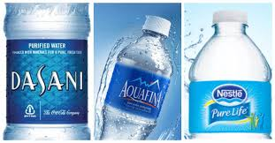
A. Collective mark
B. Certification mark
12-<number>

Slide 23
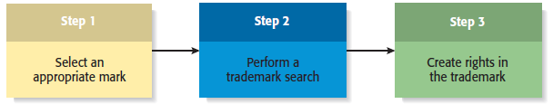
The Process of Obtaining a Trademark
12-<number>

Slide 24
Copyrights
Copyrights
  A copyright is a form of intellectual property protection that grants to the owner of a work of authorship the legal right to determine how the work is used and to obtain the benefits from the work.
  Pictures, songs, movies, poetry, software
    https://www.youtube.com/watch?v=eEB5MYcj-Ns
12-<number>

Slide 25
What is Protected By a Copyright?
Literary works
Musical compositions
Computer software
Dramatic works
12-<number>

Slide 26
Copyright Infringement
1 of 2
Copyright Infringement
  Copyright infringement occurs when one work derives from another or is an exact copy or shows substantial similarity to the original work.
  To prove infringement, a copyright owner is required to show that the alleged infringer had prior access to the copyrighted work and that the work is substantially similar to the owner’s.
12-<number>

Slide 27

Copyright Infringement
2 of 2
The illegal downloading of
music is an example of
copyright infringement.
Copyright infringement costs
the owners of copyrighted
material as estimated $20
billion per year in the U.S.
alone.
12-<number>

Slide 28
Trade Secrets
Trade Secrets
  A trade secret is any formula, pattern, physical device, idea, process, or other information that provides the owner of the information with a competitive advantage in the marketplace.
  Trade secrets include marketing plans, product formulas, financial forecasts, employee rosters, logs of sales calls, and similar types of proprietary information.
12-<number>

Slide 29

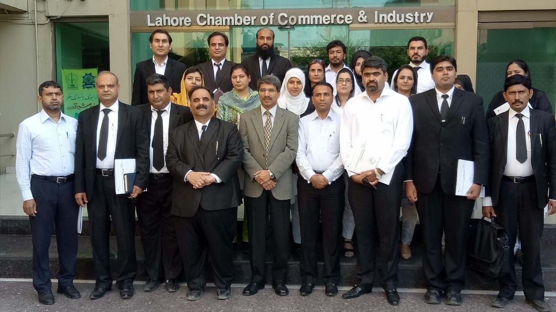
IPO Pakistan
https://ipo.gov.pk/
12-<number>

Slide 30
What Qualifies For Trade Secret Protection?
1 of 2
Trade Secret Protection
  Not all information qualifies for trade secret protection
  In general, information that is know to the public or that competitors can discover through legal means doesn’t qualify for trade secret protection
  Companies protect trade secrets through physical measures and written documents.
  https://www.youtube.com/watch?v=wMctmMin9vM
12-<number>

Slide 31
Physical Measures for Protecting Trade Secrets
Restricting access
Labeling documents
Password protecting
computer files
Maintaining logbooks
for visitors
Maintaining logbooks for
access to sensitive
material
Maintaining adequate
overall security
measures
12-<number>

Slide 32
Conducting an Intellectual Property Audit
1 of 2
Intellectual Property Audit
  The first step a firm should take to protect its intellectual property is to complete an intellectual property audit.
  An intellectual property audit is conducted to determine the intellectual property a firm owns.
  There are two reasons for conducting an intellectual property audit:
    First, it is prudent for a company to periodically determine whether its intellectual property is being properly protected.
    Second, it is important for a firm to remain prepared to justify its valuation in the event of a merger or acquisition.
12-<number>

Slide 33
Intellectual Property
https://www.youtube.com/watch?v=g4Tbq22NHag
https://www.youtube.com/watch?v=3sr42wcIaEE
https://www.youtube.com/watch?v=HsTi3vD_Usw
12-<number>

Slide 34





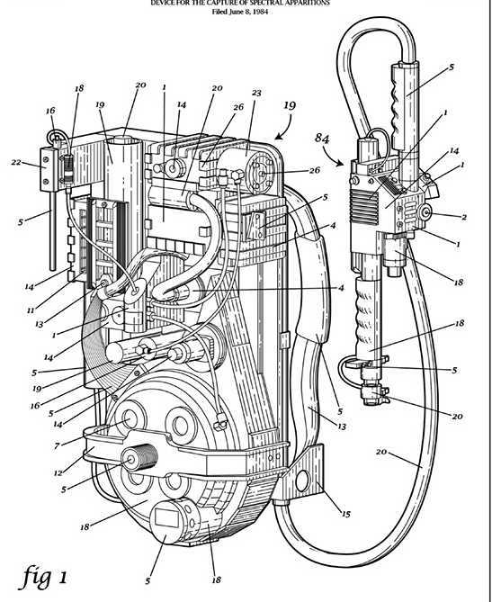
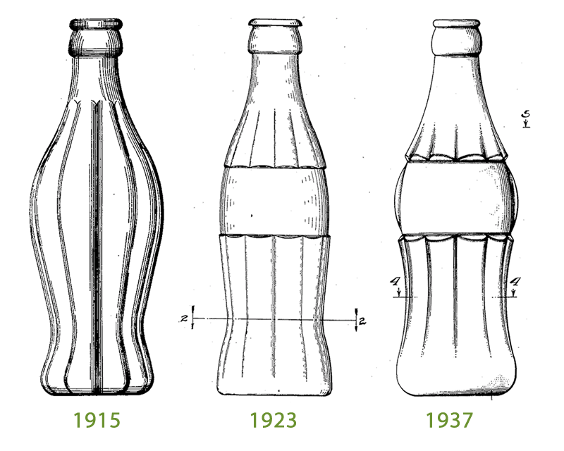

12-<number>

Slide 35

Lecture Video
https://www.youtube.com/watch?v=z2ctYnIXaJ4&list=PLWGZllDbUgo8At8Ouzi_RONyxjjUPS4mn&index=66
12-<number>

